Slide 1
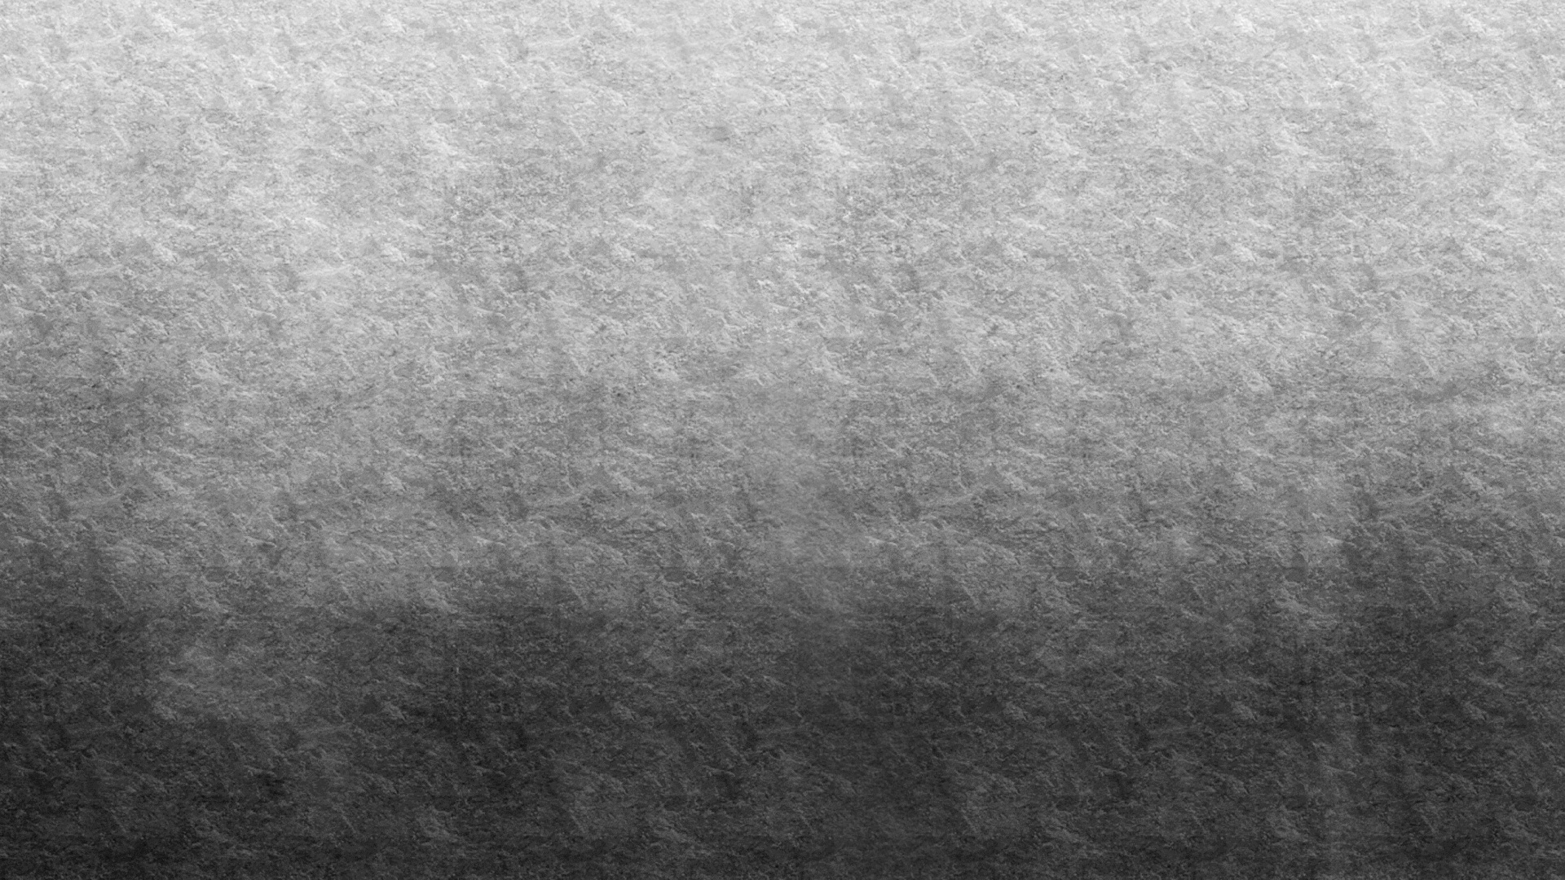

IMAGE TO CARICATURE Minor Project
Saloni 190078 Pranjal Tulsiyan 190119 Manvi Vrati 190136

Slide 2
ABSTRACT
Caricature is a comical representation of one’s image which emphasis on picturing the facial features boldly.
In this minor project, we aim to transform images into cartoon.
We will be using Python language on PyCharm. Conversion will be done by first uploading the image in the interface made by using Tkinter and then just by clicking on the Cartoonify Button.
Hence, we get the caricature of the image ready to be saved in our devices. We will be using various libraries like OpenCV, Numpy, matplotlib, etc. We will put our knowledge of Machine Learning together to create this innovative program.

Slide 3
Contribution to Society
This application can be useful for people who are interested in comic and webtoon writing to create realistic characters.
This can also be used by programmers/ hackers or other people who put their Bitmoji’s as their profile pictures as they don’t wish to reveal their faces for privacy purposes but they wish their DP to be unique.
Graphic designers also use caricatures to escape their boring routine. It turns a simple hobby to lifestyle.
Now a days caricatures are in trend. We can see several Snapchat and Facebook filters using similar techniques as well. People try using these techniques to see how different their friends or other famous people look like, once gone through the effect.
Not only it is a great source of pleasure and entertainment for several people but also an interesting way to reach a milestone in learning technology for some. So, this application can be put to a good use!

Slide 4
PLANNING [FLOW CHART]
Importing required modules
Building a File Box to choose a particular file
Reading and Resizing Image
Transforming an image to grayscale and smoothening it
Retrieving the edges of an image and to prepare a Mask Image
Giving a Cartoon Effect
Functionality of save button
Making the main window by Tkinter
Making cartoonify and save button in the main window

Slide 5
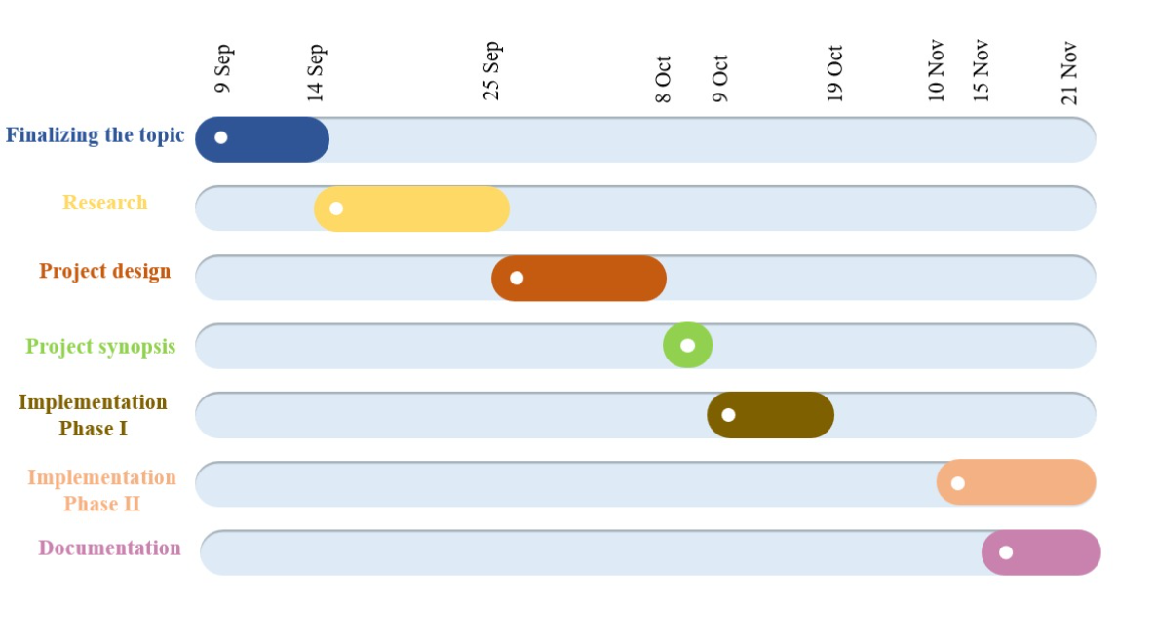
Project Timeline: Gantt Chart

Slide 6
CODE IMPLEMENTED

Slide 7
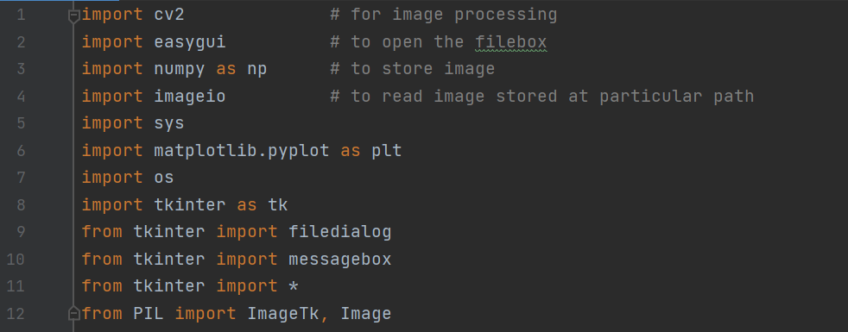
1. Importing Required Modules
The modules present in the above figure are used in our application.

Slide 8
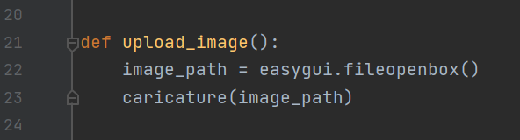
2. Building a File Box to choose a Particular File
In this step we have written the function ‘upload_image’ to open the file box, i.e., the pop-up box to choose the file from the device, which opens every time we run the code.
fileopenbox() is the method in easyGUI module which returns the path of the chosen file as a string.

Slide 9
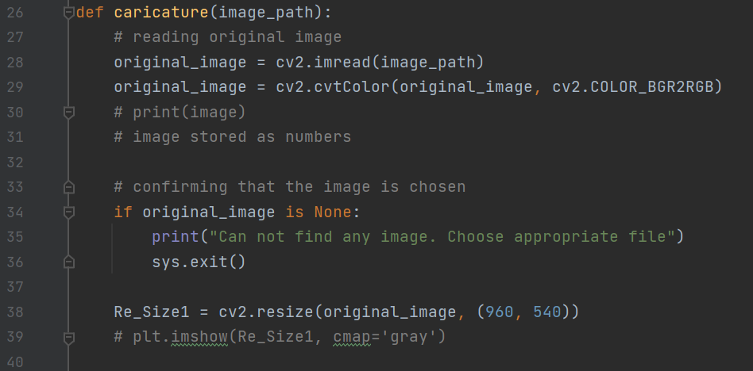
3. Reading and Resizing Image
In caricature function 1st we are reading and resizing the image.
imread is a method in cv2 which is used to store images in the form of numbers.
The image is read as a numpy array, in which cell values depict R, G, and B values of a pixel.
cvtColor(image, flag) is a method in cv2 which is used to transform an image into the colour-space mentioned as ‘flag’.
We will resize the image after each transformation to display all the images on a similar scale at last.

Slide 10
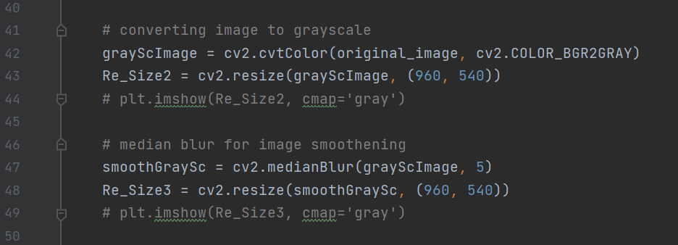
4. Transforming an image to grayscale and smoothening it
To convert an image to a cartoon, several transformations are done. The image is converted to a Grayscale image. Then, this Grayscale image is smoothened. After this we try to extract the edges in the image. Finally, we form a color image and mask it with edges. This creates a beautiful cartoon image with edges and lightened color of the original image.
Here, to convert the image in grayscale, we have used the BGR2GRAY flag. This returns the image in grayscale. To smoothen an image, we simply apply a blur effect. This is done using medianBlur() function. The center pixel is assigned a mean value of all the pixels. This in turn, creates a blur effect.

Slide 11
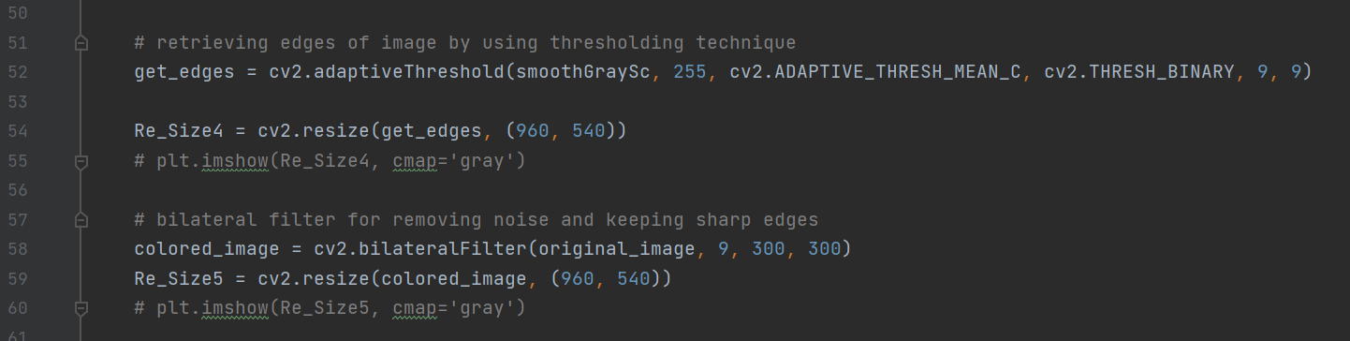
5. Retrieving The Edges Of An Image And To Prepare A Mask Image
Caricature has 2 specialities: its highlighted edges and smooth colours.
So, we need to bring out the edges and make them bold so that they highlight even more. For this we take mean of neighbourhood pixel values minus the constant.
The type of threshold applied is THRESH_BINARY.
For masking the image, the bilateral filter is used that removes the noise from image. This is smoothening of an image. Similar to beautify image option we have in mobile cameras.

Slide 12
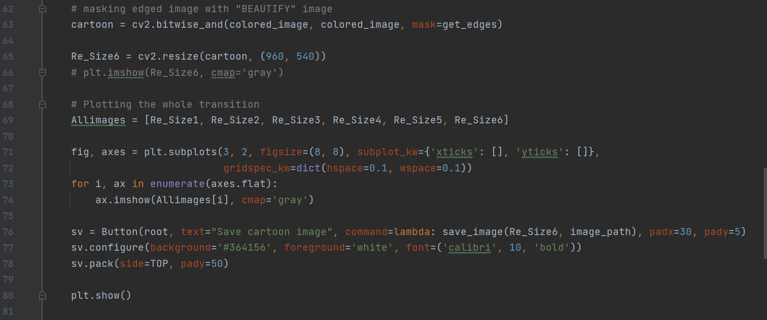
6. Giving A Cartoon Effect
We need to combine the beautified image and the bold retrieved edges together to obtain a caricature image. Bitwise AND operation is performed on two images and this is called Masking. Plotting the transitions together using matplotlib, we first create axes and display images in each block.

Slide 13
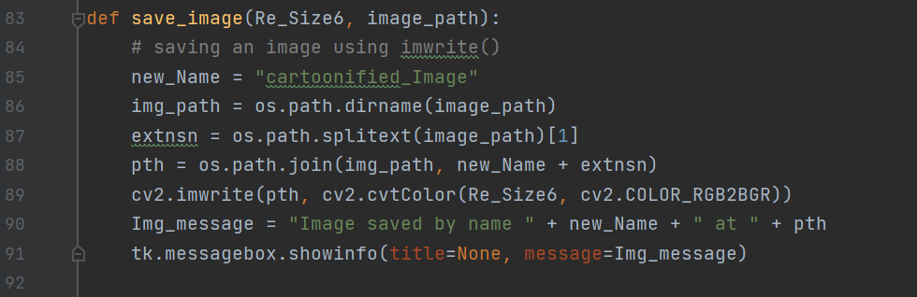
7. Functionality Of Save Button
To save the image we have created, we take the old image path to save image in the same folder and have predefined the name: “cartoonified_image”. For taking the image path using the library OS

Slide 14
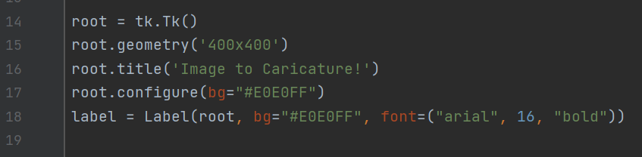
8. Tkinter window
Making the window using tkinter is upon the user, it can be done according to our preferences. At the end of the file we need to write root.mainloop() so that the tkinter window appears as soon as the main program is executed.

Slide 15
9. Making The Cartoonify And Save Button In The Main Window
Following are the snippets to make the save button and cartoonify button:
Upload button
Save button

Slide 16
OUTPUT CARICATURE

Slide 17
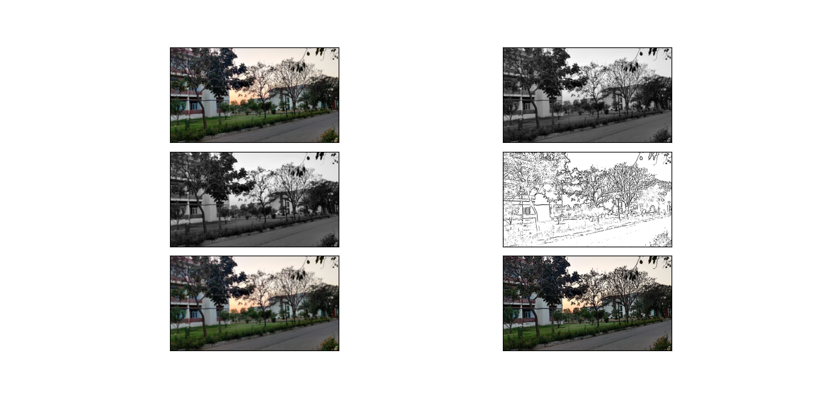
Image in different steps:

Slide 18
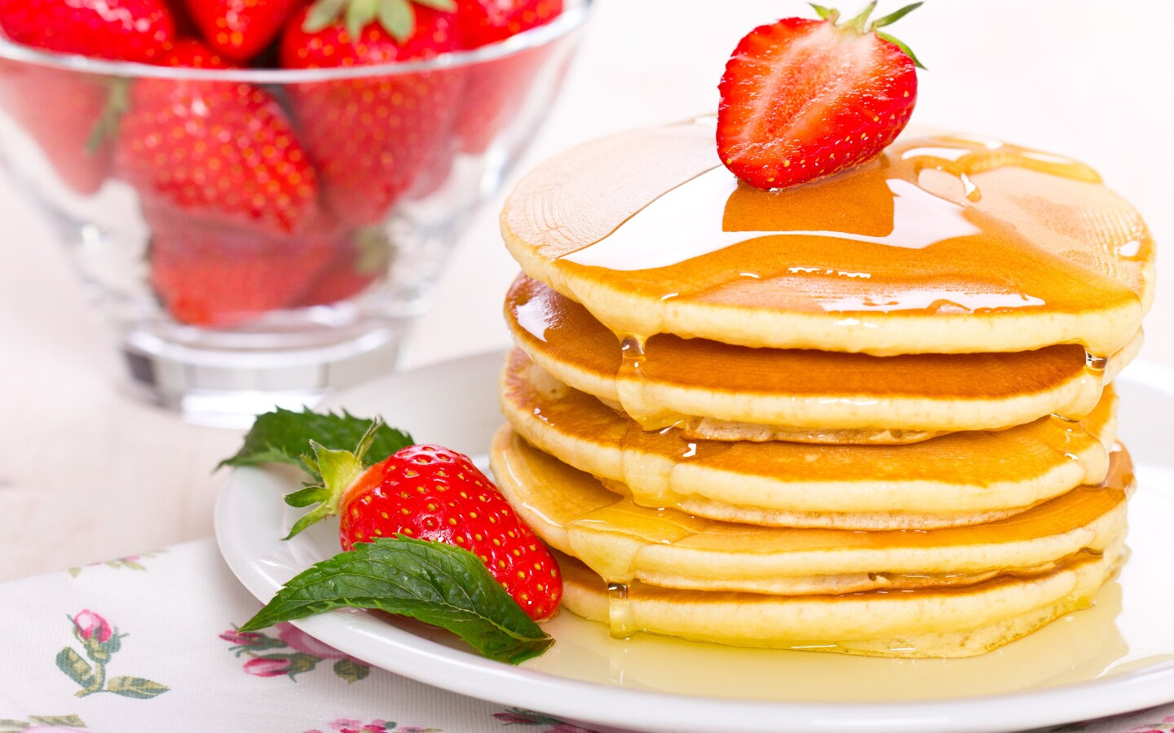
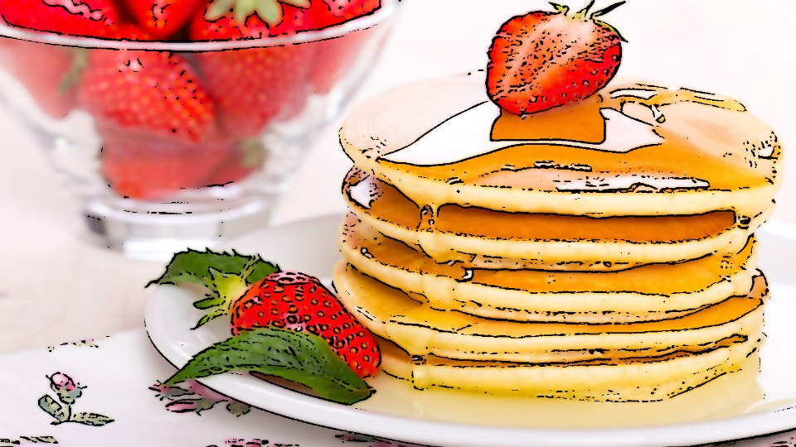
Original Image
→ Output Image

Slide 19
CONCLUSION
In this project with the help of OpenCV, we have transformed images (snapshots) to the finest caricature of them. Also, with the help of CV2 which is known as Computer vision, we have transformed images in such a way that every image will have its own unique features on being cartoonified as, the features used to cartoonify them are not predefined. They are retrieved from the qualities of the original image itself.

Slide 20
LIMITATIONS
In this project, we can see that dimensions are fixed, i.e., when we take an image of any size [dimension wise] we get the caricature image in the dimensions that we have already given in the project. The dimensions are static so, some times we get an image that is slightly compressed. Also, image quality decreases a bit after the task is performed. Moreover, caricature image can only be clearly identified, if the original image quality is high, otherwise sometimes the difference may not be visible to bare eyes. This process is a general one and will not give the best result for different types of images.

Slide 21
SCOPE FOR FUTURE WORK
We can find a proper way to save images by user defined names. We can work on the point that caricature can be obtained from any size of image, considering all dimensions possible. The library cv2 can be explored and the quality of produced image can be improved. If the program is further converted into application, we can link this to SQLite or other databases to store all information.

Slide 22
REFERENCES
https://www.tutorialspoint.com/
https://www.geeksforgeeks.org/
https://data-flair.training/

